Slide 1
Getting SQL Service Broker Up and Running
Denny Cherry
mrdenny@dcac.co
twitter.com/mrdenny

Slide 2

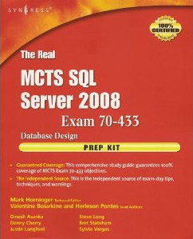

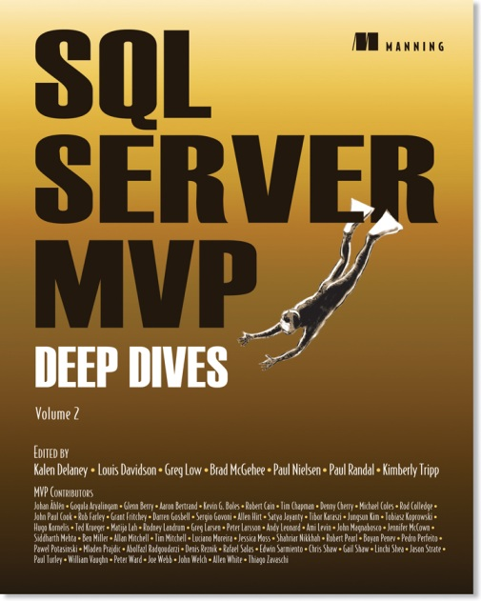



About Me
Owner of Denny Cherry & Associates Consulting
Author or Coauthor of 5 books
8+ SQL Mag articles
Dozens of other articles
Microsoft MVP
Microsoft Certified Master
VMware vExpert

Slide 3
Service Broker Concepts
Similar to other queuing technologies
Data is processed using SEND and RECEIVE instead of SELECT and INSERT
Data is sent as an XML data in a binary format.
Queues can be processed automatically or on demand

Slide 4
Service Broker Concepts
Messages can be sent within the database, to another database on the server, or to a database on a remote server
Delivery is guaranteed, and in the order sent
Messages are processed once and only once, in the order received
Messages can range in size from single bytes to mega-bytes in size (max size of ~1GB per message)

Slide 5
Important SSB Queries
select * from sys.conversation_endpoints
select * from sys.transmission_queue
Select * from dbo.QueueName

Slide 6
Changes in SQL Server 2008
Conversation Priorities
ssbdiagnose – command line app
System Monitor Object and Performance Monitor Counters

Slide 7
Demo…

Slide 8
SQL Server Web Sites
http://www.microsoft.com/sql
http://itke.techtarget.com/sql-server/
http://www.searchsqlserver.com/
http://technet.microsoft.com/en-us/library/ms166044.aspx - Good SSB troubleshooting site

Slide 9
Denny Cherry
mrdenny@dcac.com
www.dcac.co
twitter.com/mrdenny
Please rate this session at http://speakerrate.com/mrdenny

